Slide 1
Revamping Hyperspectral Image Security with LAB color space Encryption
CS6811 - Project Work
Ramyaa P (2019503547), Priyadharshini R (2019503034), Pramoth Guhan (2019503574)
Guided by Dr. S. Neelavathy Pari
Assistant Professor (Sr. Grade)
Department of Computer Technology
Anna University, MIT Campus

Slide 2
Introduction
Hyperspectral imaging is a remote sensing technology that captures and analyses the spectrum of light reflecting off an object, providing a wealth of information about its chemical and physical properties. However, it's frequently necessary to prevent unauthorised access to the delicate information that one’s hyperspectral photographs contain. In order to protect one’s hyperspectral data, encryption is used. However, this method comes with a number of drawbacks, including higher computational complexity, decreased image quality, difficult key management, compatibility concerns, and decreased performance.

Slide 3
Problem Statement
Hyperspectral imaging technology has become an indispensable tool in various industries such as agriculture, mineral exploration, and environmental monitoring. However, it's frequently necessary to prevent unauthorised access to the delicate information that hyperspectral photographs contain. Although encryption is a popular method for protecting hyperspectral data, it also comes with a number of difficulties. The original hyperspectral data may change during the encryption process, reducing the quality of the image and changing how it can be analysed. Usually encryption converts hyperspectral images only to RGB color space. Secure key management is necessary for the usage of encryption as well, and this process can be difficult and time-consuming. Additionally, not all image processing tools may be compatible with encrypted hyperspectral pictures, restricting their usability in some applications.

Slide 4
Objective
The objectives of this project include
To create a novel hyperspectral image encryption algorithm that is especially made for photos utilising LAB colour space.
To ensure that the encrypted photos are secure and the data isn't lost by optimising the unique technique to balance security and data loss.
To make sure the suggested encryption algorithm satisfies the requirements for use in practical applications, assess its performance in terms of speed, security level, and attack resistance.
To evaluate the effectiveness and advantages of the proposed method, numerous metrics are used to compare its performance to those of existing encryption algorithms.
To examine whether the suggested algorithm is appropriate for practical applications, specifically remote sensing to make sure it satisfies their unique requirements.

Slide 5
Literature Survey

Slide 6
S.No. | Name | Description | Limitations
[1] | " Hyperspectral Imaging: A Review on UAV-Based Sensors, Data Processing and Applications for Agriculture and Forestry." The Journal Remote Sensing , 2017 | It provides a comprehensive review of the current state of unmanned aerial vehicle (UAV)- based hyperspectral imaging for agriculture and forestry. The paper covers the sensor technology used with respect to UAV and various data processing methods used in hyperspectral imaging. | It focuses solely on using UAV-based sensors for agriculture and forestry applications, neglecting other important remote sensing technologies and applications and does not provide in-depth analysis or suggestions for how to address challenges.
[2] | "Experimental comparison of color spaces for material classification" Journal of Electronic Imaging , 2017 | This paper evaluated the performance of each color space using three different classification methods: The results showed that CIELAB and CIELUV outperformed RGB and HSV in all classification methods. Overall, the study suggests that using CIELAB or CIELUV color spaces can improve the accuracy of material classification | This paper used a dataset of only 10 different materials, which may not be representative of the full range of materials that could be encountered in real-world applications.
Notes:
Lit survey summary

Slide 7
S.No. | Name | Description | Limitations
[3] | "A nonlinear image encryption method based on multivariate polynomials," Optik - International Journal for Light and Electron Optics , 2012 | The proposed work in [3] aims to present a multivariate polynomial-based nonlinear image encryption technique. The suggested method shows promising results in terms of encryption efficiency and security and provides improved resistance against different cryptographic attacks. | The proposed nonlinear image encryption method based on multivariate polynomials may have limitations in terms of computational complexity, especially for larger images or high-resolution images. The proposed method may not provide explicit mechanisms for key management
[4] | " A uniform illumination image enhancement via linear transformation in CIELAB color space" Multimed Tools Appl 81, 2022 | The proposed method in [4] is based on linear transformation in the CIELAB color space, which separates the color information from the brightness information in the image. The proposed method was evaluated using several metrics, including peak signal-to-noise ratio (PSNR), structural similarity index (SSIM), and visual quality assessment (VQA). | The proposed method works well for simple color distributions, but may not be effective for complex color distributions. Its effectiveness is limited to linear transformations in the CIELAB color space, and may not work as well with nonlinear transformations.
Notes:
Lit survey summary

Slide 8
S.No. | Name | Description | Limitations
[5] | " Optical encryption of hyperspectral images using improved binary tree structure and phase-truncated discrete multiple-parameter fractional Fourier transform" IOP Publishing Ltd Journal of Optics, 2020 | [5] discusses a method for encrypting hyperspectral images using a combination of an improved binary tree structure and a phase-truncated discrete multiple-parameter fractional Fourier transform. Using numerical simulations, the research also seeks to show how successful the suggested strategy is. | Without access to the details of the numerical simulations, it is challenging to ascertain the validity of the results or evaluate the generalizability of the proposed approach to different hyperspectral datasets. The proposed algorithm still has limitations or vulnerabilities that have not been addressed in the study.
[6] | " A novel content-selected image encryption algorithm based on the LS chaotic model” Journal of King Saud University - Computer and Information Sciences, 2022 | The paper proposed a content selection module where a chaos based random number generator is used to select the content of the image to be encrypted and encryption and decryption module which uses LS chaotic maps to generate encryption keys. | One drawback of [6] is the ambiguous determination of boundaries during target detection
Notes:
Lit survey summary

Slide 9
S.No. | Name | Description | Limitations
[7] | "A Novel Image Encryption Algorithm Based on Multistage Chaos System and DNA Encoding" Journal of Computational and Theoretical Nanoscience, 2021 | The paper presents a novel image encryption algorithm based on a multistage chaos system and DNA encoding. The proposed algorithm showed promising results in terms of encryption strength and robustness, making it suitable for secure image communication and storage applications. | The proposed image encryption algorithm based on a multistage chaos system and DNA encoding may have limitations in terms of computational efficiency and speed, especially for large or complex images.
[8] | " How Good Are RGB Cameras Retrieving Colors of Natural Scenes and Paintings?—A Study Based on Hyperspectral Imaging" Sensors MPDI, 2018 | The researchers found that while RGB cameras were able to capture colors in natural scenes with a reasonable degree of accuracy, they struggled to capture the full range of colors in paintings. This was particularly evident in the reproduction of subtle color variations and the accurate depiction of colors in shadows and highlights. | This study is conducted using a specific type of RGB camera and hyperspectral imaging system. The results may not be generalizable to other cameras or imaging systems. The study did not examine the impact of post-processing techniques on the accuracy of color reproduction.
Notes:
Lit survey summary

Slide 10
S.No. | Name | Description | Limitations
[9] | "An image encryption scheme based on hyper-chaotic system and dynamic state variables" Multimedia Tools and Applications, Volume 75, Issue 16, pages 9915-9928, 2016 | The paper presents an image encryption scheme that utilizes a hyper-chaotic system and dynamic state variables. The proposed scheme aims to enhance the security of image encryption by introducing chaotic dynamics and dynamically changing the encryption parameters. | The limitation of the proposed scheme is its computational complexity, which may affect the encryption and decryption speed for large images or real-time applications. Additionally, the scheme's robustness against various cryptographic attacks and its resistance to statistical analysis need further investigation and evaluation.
[10] | "Modern Trends in Hyperspectral Image Analysis" IEEE Access, vol. 6, pp. 14118-14129, 2018, doi: 10.1109/ACCESS.2018.2812999, 2018 | This study explores the widespread use of hyperspectral imaging for various tasks such as managing water resources, identifying military targets, etc. An automatic forgery detection system based on HSI and deep learning has shown promising results. | The limitation of this paper is that while it emphasises the importance of hyperspectral photography in estimating physical characteristics, it does not provide a clear explanation of further applications based on airborne and spaceborne hyperspectral platforms.
Notes:
Lit survey summary

Slide 11
S.No. | Name | Description | Limitations
[11] | " Comparison of HSV and LAB Color Spaces for Hydroponic Monitoring System. " 5th International Conference on Information Technology, Computer, and Electrical Engineering, 2018 | [11] aims to investigate which colour space, i.e, HSV or Lab colour space is better in comparison for use in a hydroponic monitoring system. The authors aim to identify which colour space is suitable for the application by processing the pictures using both colour spaces to detect nutrient deficiencies in hydroponic plants. | [11] only compares both the colour spaces in the context of hydroponic monitoring. They have also not considered other colour spaces such as RGB.
[12] | " A novel image encryption algorithm based on DNA encoding and spatiotemporal chaos." Mathematical Problems in Engineering 2015 | [12] proposes an image encryption technique based on DNA encoding and spatiotemporal chaos. Three steps make up the algorithm: turning the image into a DNA sequence, submitting it to spatiotemporal chaos, and creating an encrypted image. To solve the problem of image encryption, the method offers a novel mix of DNA encoding and spatiotemporal chaos. | The algorithm's potential sensitivity to noise is one of its limitations. Because the technique depends on spatiotemporal chaos to jumble the DNA sequence, even minor system perturbations could have a big impact on the outcome.
Notes:
Lit survey summary

Slide 12
S.No. | Name | Description | Limitations
[13] | "A novel image encryption algorithm based on hyper-chaotic system," Journal Optics Communications, Volume 291, pages 242-247, 2013 | The paper presents a novel image encryption algorithm that utilizes a hyper-chaotic system. The proposed algorithm aims to improve the security of image encryption by incorporating chaotic dynamics and non-linear transformations into the encryption process. | The limitation of the proposed algorithm is the computational overhead associated with the generation and manipulation of hyper-chaotic sequences, which may affect the encryption and decryption speed for large images or real-time applications.
[14] | "A secure and high-efficiency image encryption scheme based on 3D Henon map and discrete wavelet transform," journal Signal Processing: Image Communication, Volume 97, pages 116225-116237, 2021 | The paper presents a novel image encryption scheme that combines the 3D Henon map and discrete wavelet transform and it aims to achieve both high security and high efficiency in image encryption. The 3D Henon map is used to generate encryption keys, while the discrete wavelet transform is used for image scrambling and diffusion. | The limitation of the proposed scheme is the vulnerability to chosen-plaintext attacks. The robustness of the scheme against various cryptographic attacks and its performance in terms of encryption speed needs to be further evaluated with other encryption algorithms.
Notes:
Lit survey summary

Slide 13
S.No. | Name | Description | Limitations
[15] | " A Novel Signature and Authentication Cryptosystem for Hyperspectral Image by Using Triangular Association Encryption Algorithm in Gyrator Domains" Journal Applied Sciences 2022. | [15] proposes a system which first performs a gyrator transformation on the hyperspectral image to transform it into frequency domain. This is then encrypted using triangular association encryption algorithm. The encrypted image is then signed using a digital signature algorithm to ensure the authenticity and integrity of the image. | Some limitations of the proposed system in [15] can be the requirement of significant computational resources depending on the size and complexity of the hyperspectral image being encrypted.
[16] | " A novel chaotic image encryption algorithm based on content-sensitive dynamic function switching scheme" Optics & Laser Technology, 2019 | The suggested encryption algorithm uses a 1D byte sequence and is a symmetric cypher. To achieve confusion and diffusion qualities, simple image bytes are scrambled using three separate chaotic maps and sorted. | It involves challenging mathematical processes and could call for significant processing resources, which might make it impractical to utilise in circumstances with limited resources.
Notes:
Lit survey summary

Slide 14
S.No. | Name | Description | Limitations
[17] | "Spiral-Transform-Based Fractal Sorting Matrix for Chaotic Image Encryption" IEEE Transactions on Circuits and Systems I: Regular Papers, 2022 | In [17], a novel chaotic image encryption method based on the spiral-transform-based fractal sorting matrix. They develop a new chaotic picture encryption and decryption system employing STFSM as the algorithm's core. | The average value of the information entropy of the encrypted images obtained by the method proposed in [17] is not as closer to the theoretical value than others.
[18] | "A New Full Chaos Coupled Mapping Lattice and Its Application in Privacy Image Encryption," IEEE Transactions on Circuits and Systems, 2022 | Paper [18] presents a proof of resistance to dynamic degradation, and explains that the computer realises the chaotic encryption algorithm, but it will not lead to the problems of dynamic degradation of a chaotic system. The tests for bifurcation graphs, Lyapunov exponents, and Shannon entropy reveal that TWMCML exhibits more unpredictability and chaos. | Although the suggested technique performs well, it takes too long to iterate TWMCML, according to the encryption time study.
Notes:
Lit survey summary

Slide 15
S.No. | Name | Description | Limitations
[19] | "Hyperspectral Image Classification With Deep Learning Models” IEEE Transactions on Geoscience and Remote Sensing, 2018 | For the purpose of assessing the efficacy of the suggested models, six openly accessible hyperspectral image data sets were used in this study. The proposed deep learning models, particularly the R-3-D-CNN and the R-2-D-CNN deep learning models, are superior, according to experimental results. | The effectiveness of the proposed deep learning models may depend on the availability and size of the training dataset.
[20] | " A Novel Image Encryption Algorithm Based on Multiple Chaotic Maps and DNA Encoding," IEEE Access, 2021 | Permutation, substitution, and diffusion are the three basic stages of the algorithm described in [20]. These steps serve as the foundation for the encryption method, which combines multiple chaotic map and DNA encoding. It has significant security traits, proving its capacity to successfully protect critical information. | When employing DNA subsequence operations that are based on horizontal orientation or selecting longer subsequences, there is a potential for an increase in the horizontal correlation among neighboring pixels in the original image.
Notes:
Lit survey summary

Slide 16
Implemented Work
Our work is developing an improved encryption algorithm for hyperspectral images converted to L*a*b colour space after preprocessing based on the difficulties outlined above. This technique is expected to reduce the trade-off between security and image data loss. To accomplish this, we examine various encryption methods and evaluate their performance in terms of computational complexity, image quality and overall performance. Then we create and implement a novel encryption algorithm that overcomes the shortcomings of existing techniques and provides a reliable and effective method especially for encrypting L*a*b color space hyperspectral images. The proposed algorithm is tested using the most common tests and compared to other encryption techniques to determine its effectiveness. Our ultimate goal is providing a practical solution for the safe storage of hyperspectral images while preserving value.
Notes:
While there are various encryption techniques available, they all have shortcomings, and we need a reliable and effective method to encrypt Lab color space hyperspectral images. Our proposed algorithm will overcome these challenges and provide a practical solution for the safe storage of hyperspectral images while preserving value.
To accomplish this, we will examine various encryption methods and evaluate their performance in terms of computational complexity, image quality, and overall performance. We will also analyze the challenges associated with existing encryption techniques and identify areas for improvement. Based on our analysis, we will create and implement a novel encryption algorithm that will provide a reliable and effective method for encrypting Lab color space hyperspectral images.
Furthermore, we will develop a user interface that will allow users to upload hyperspectral photos and receive encrypted versions. The user interface will be user-friendly, and it will provide a simple and straightforward method for encrypting hyperspectral images.

Slide 17
Novelty of the Work
Encryption - Decryption algorithm specifically designed for L*a*b color space

Slide 18
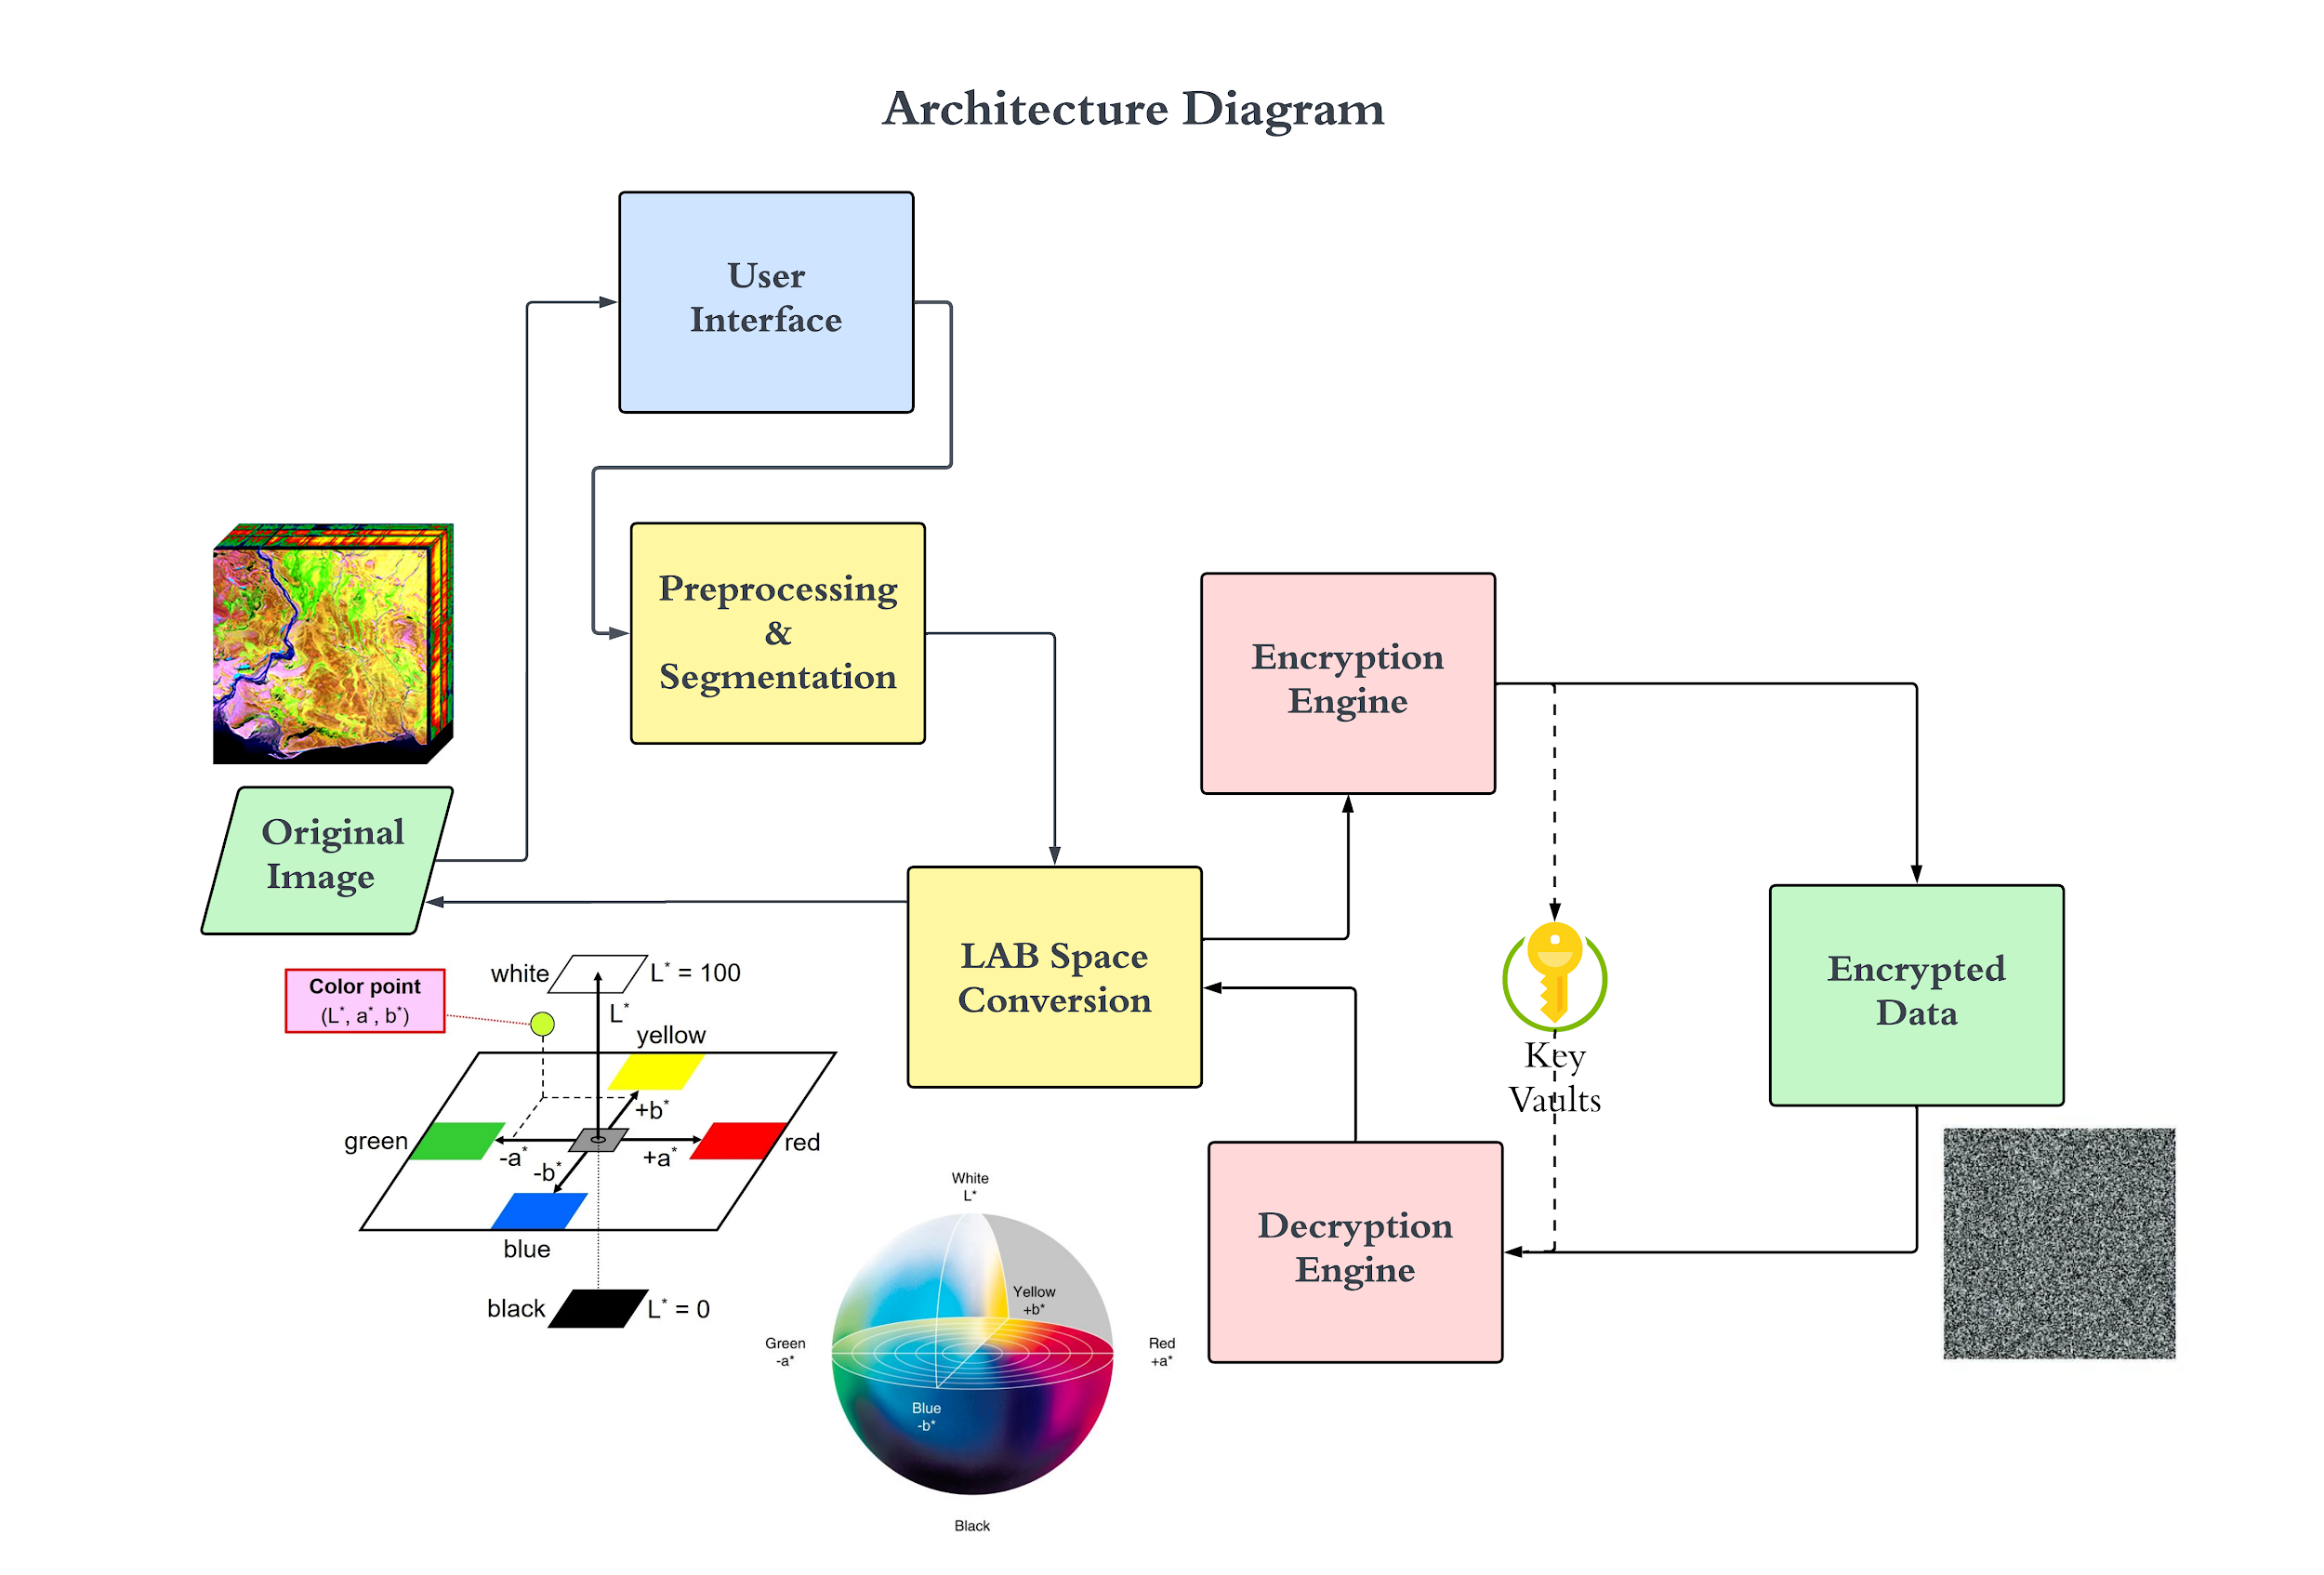

Slide 19
Module wise Implementation

Slide 20
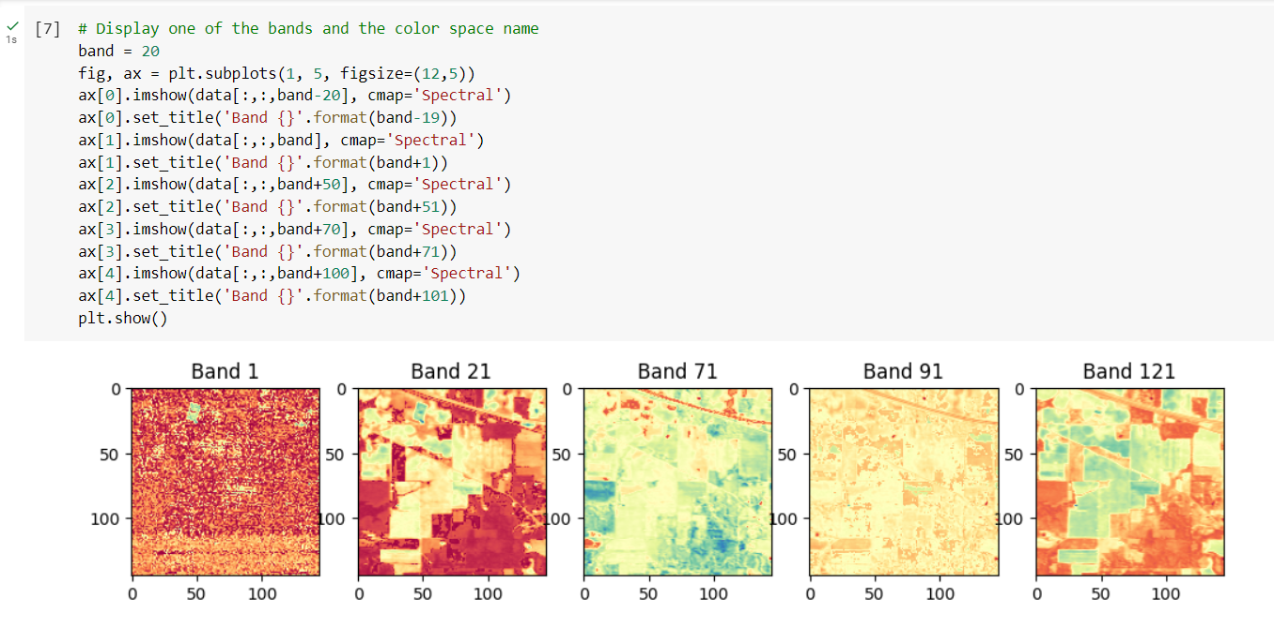
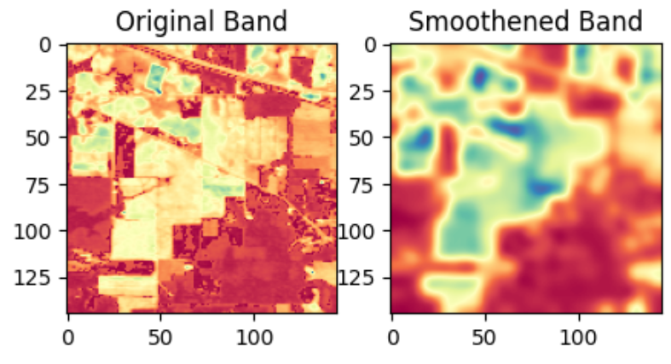
Module 1: Hyperspectral Images Preprocessing
The PCA-transformed data was then normalised to have values between 0 and 1, and reshaped to three-dimensional array.
PCA helps to reduce the dimensionality of the data and remove any correlated features
Normalising the data ensures that all features are on a similar scale, which can prevent any one feature from dominating the analysis or encryption process.
Gaussian Filter is applied to remove noise.
Notes:
Module 1: Hyperspectral Images Preprocessing
In this module, we are working with a hyperspectral image dataset that is stored in Google Cloud Storage. The first step in processing this data is to apply various preprocessing techniques. These techniques are necessary to prepare the image for encryption.
Image segmentation techniques such as edge detection, line detection and feature extraction are applied to the hyperspectral image dataset.
Module 2: Component for Lab Color Space Conversion
After the hyperspectral image has been preprocessed, the next step is to convert it from its initial form to the Lab color space. This conversion is performed using Python.
Converting the image to the Lab color space helps to minimize the dimensionality of the image. This reduction in dimensionality is necessary to improve the performance of the encryption algorithm that will be applied to the image.
Module 3: Engine for Encryption and Decryption
In this module, we will be working with an encryption and decryption algorithm designed specifically for LAB space images. The algorithm is contained in this component.
The encryption and decryption algorithm works by transforming the Lab color space image into a format that is resistant to attack. This transformation ensures that the hyperspectral image data remains secure during transmission and storage.
Overall, these three modules work together to create a secure and efficient system for processing and encrypting hyperspectral images.

Slide 21
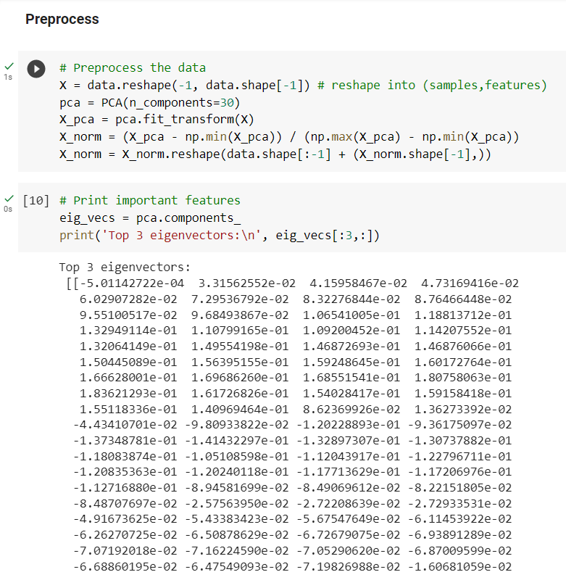
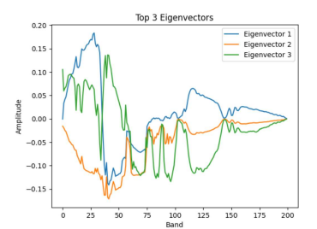
Image Preprocessing

Slide 22
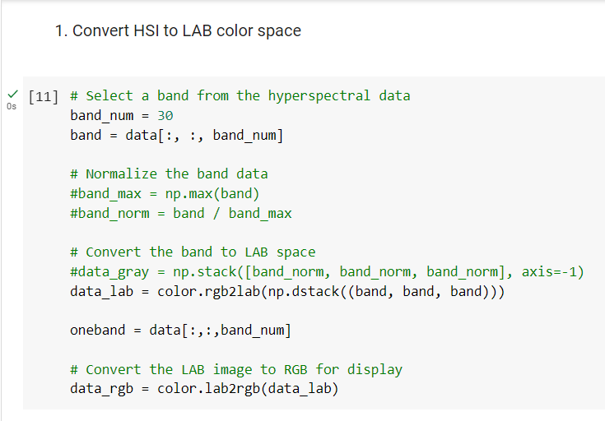
Module 2: Component for L*a*b Color Space Conversion
The image is initially changed in this module to the LAB colour space.
This is an essential stage in the encryption process since it enables us to separately apply the chaotic permutation matrix to the image's different colour channels (L, a, and b).

Slide 23
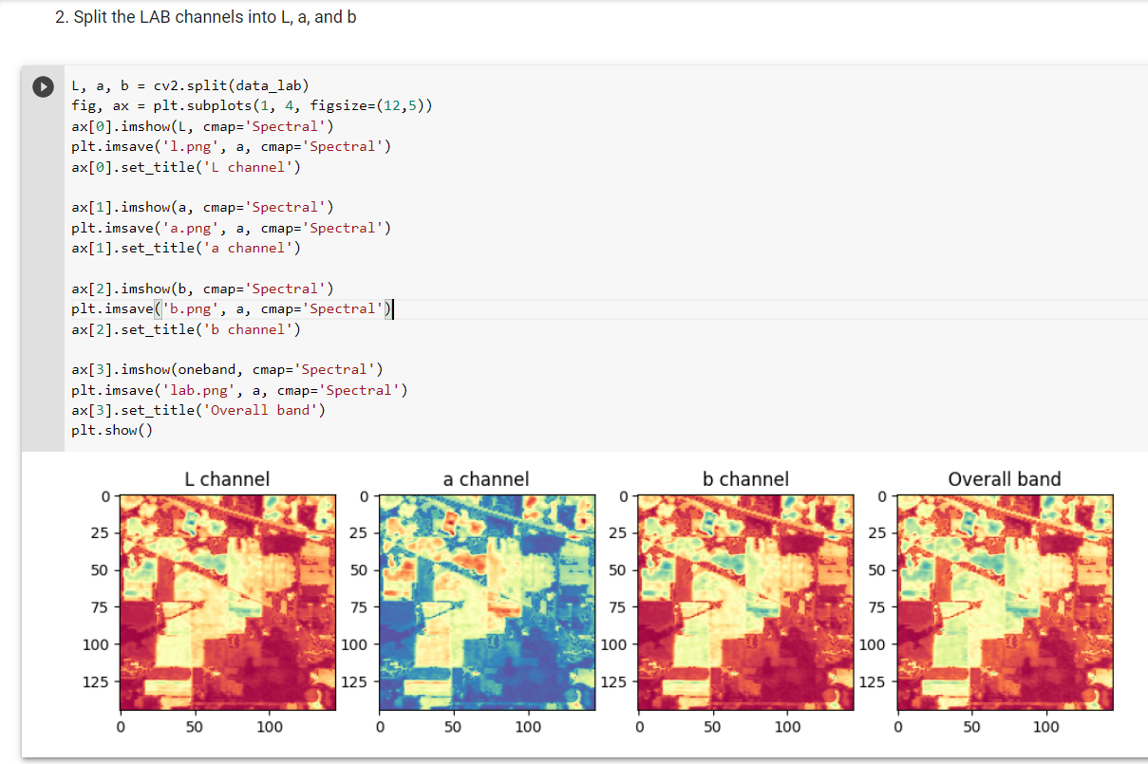

Slide 24
Module 3: Engine for Encryption
Proposed Algorithm : Pseudorandom Chaotic Image Scrambling (PCIS)
Input:
● img: An image represented as a 3-dimensional numpy array with shape (height, width, channels) in BGR color space.
● keys: A list of 3 pseudorandom number generator keys for each color channel in LAB color space.
Output:
● img_scrambled: An encrypted version of the input image represented as a 3-dimensional numpy array with shape (height, width, channels) in LAB color space.
● keys: The same list of keys passed in as input.

Slide 25

Algorithm:
Convert the input image from BGR (Blue, Green, Red) color space to LAB color space and store it in a new variable img_lab.
Initialise the pseudorandom number generator for each color channel using the keys passed in as input.
Create a chaotic permutation matrix for each color channel using the following steps:
a. Initialize three variables perm_l, perm_a, and perm_b as numpy arrays of zeros with the same shape as the first two dimensions of img_lab.
b. For i in range(5), update the permutation matrices using the following formula:
c. Reshape the permutation matrices into 1D arrays, sort them and reshape it back into 2D matrices with the same shape as perm_l, perm_a, and perm_b and store the resultant matrices.
Generate a random mask for each color channel using the corresponding pseudorandom number generator.
Scramble the image using the masks and permutation matrices:
a. XOR the L, A, and B channels of img_lab with mask_l, mask_a, and mask_b, respectively.
b. Merge the resulting channels back into a 3-dimensional numpy array using cv2.merge(), and store the result in a new variable img_scrambled. 13
c. Apply the permutation matrices to each channel of img_scrambled using np.take() and reshape() them.
Return the scrambled image and the three random number generators as output.

Slide 26
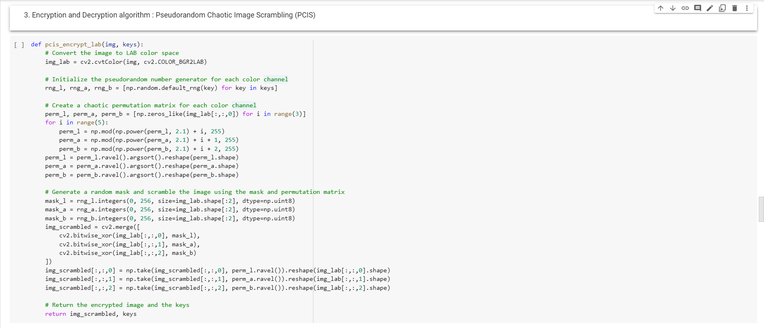
Encryption using Pseudorandom Chaotic Image Scrambling (PCIS)

Slide 27
Module 4: Engine for Decryption
Proposed Algorithm : Pseudorandom Chaotic Image Scrambling (PCIS)
Input:
img_scrambled: An encrypted version of the input image represented as a 3-dimensional numpy array with shape (height, width, channels) in LAB color space.
seed: The same list of keys passed in as encryption input.
Output:
img: An image represented as a 3-dimensional numpy array with shape (height, width, channels) in BGR color space.

Slide 28
Algorithm:
Initialize three pseudorandom number generators with the seed provided in the input.
Create three permutation matrices by applying a chaotic map to a zero matrix. The map is defined as
where `perm` is the previous permutation matrix (or the zero matrix for the first iteration) and `i` is the iteration number and α is in a range of 2 to 3. The output is then sorted to create a permutation matrix that can be applied to the corresponding color channel of the input image.
Generate three masks which will be used to XOR with the unscrambled image to obtain the original image.
Reshape the masks to match the shape of the scrambled image using `np.broadcast_to()`.
Unscramble the image
Apply the corresponding permutation matrix and XORing with the corresponding mask for each color channel.
Reshape the permutation matrix, then reordering the corresponding color channel of the scrambled image, and finally reshaping it back to the original shape.
The unscrambled color channels are obtained by XORing the unscrambled image with the corresponding masks.
Convert the unscrambled image from LAB color space to BGR color space.
Return the unscrambled image.

Slide 29
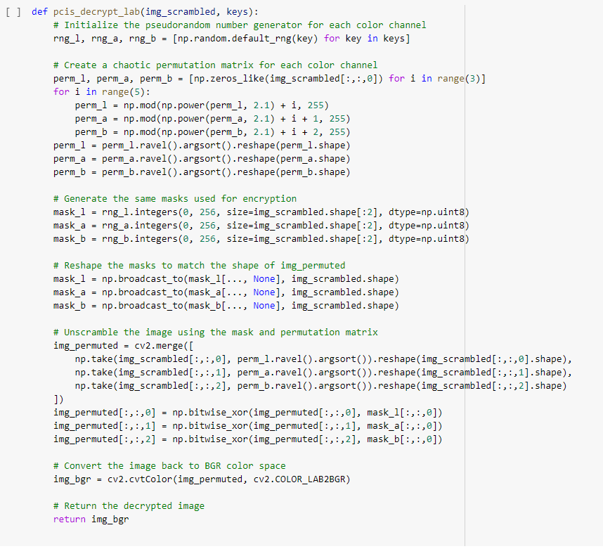
Decryption using Pseudorandom Chaotic Image Scrambling (PCIS)

Slide 30
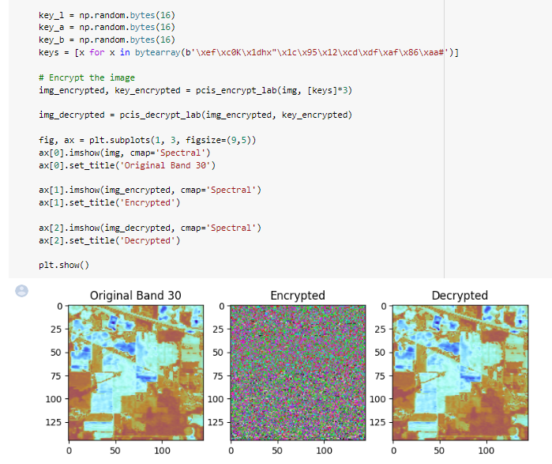
Results

Slide 31
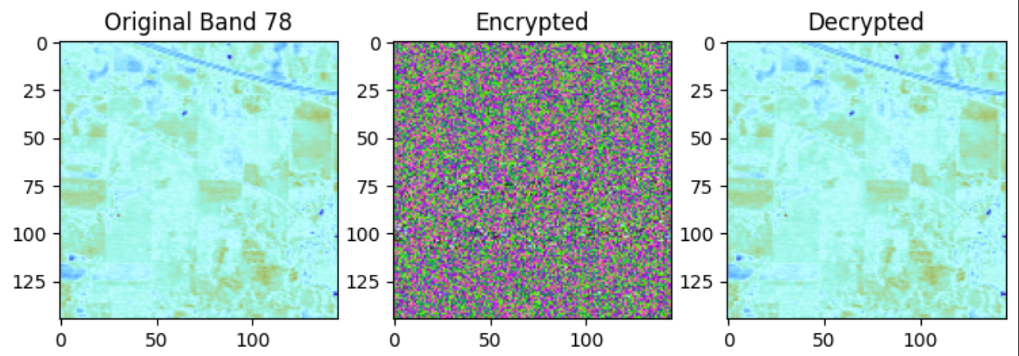
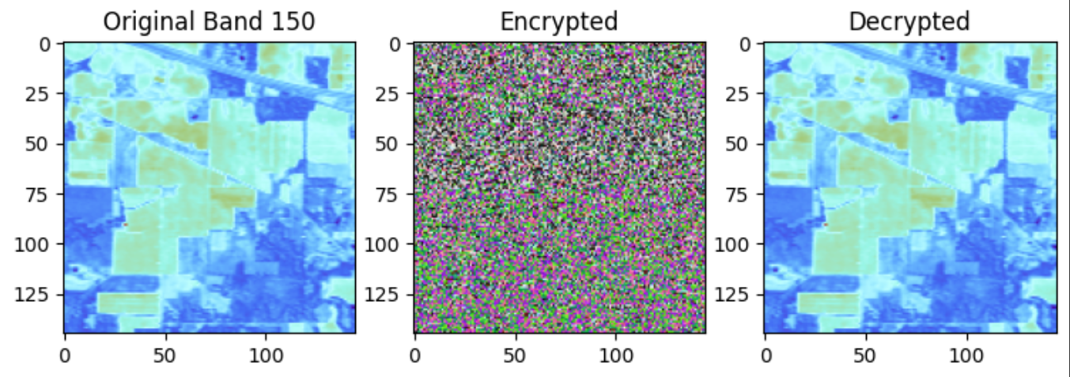
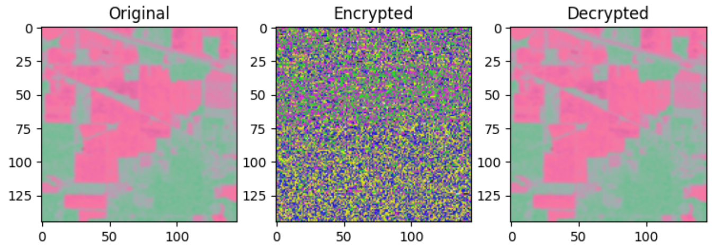
Sample image bands over Encryption and Decryption algorithm

Slide 32
Metrics and Discussion

Slide 33
For this algorithm, we compute three image quality metrics: Peak Signal-to-Noise Ratio (PSNR), Structural Similarity Index (SSIM), and Mean Squared Error (MSE). These metrics are important for evaluating the performance of image encryption and decryption algorithms.
The PSNR measures the ratio of the maximum possible power of the signal to the power of the noise, and is expressed in decibels (dB). The higher the PSNR value, the better the quality of the decrypted image.
The SSIM compares the structural similarity between the original and decrypted images, and ranges between -1 and 1, where 1 indicates perfect similarity.
The MSE measures the average squared difference between the original and decrypted images, with lower values indicating better quality. In this case, the obtained scores are higher than the reference scores, indicating that the decryption algorithm performed well in terms of image quality.

Slide 34
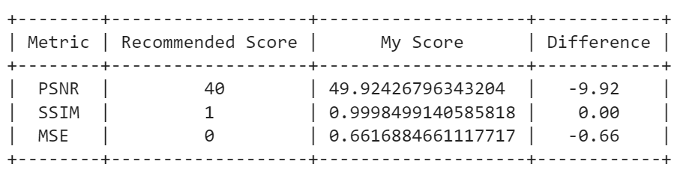
The predicted PSNR value varies depending on whether a lossless or lossy encryption technique is used when assessing the quality of encrypted images.
The PSNR values of lossless encryption techniques are often greater since the original image may be completely recreated without losing any data. For lossless encryption, PSNR values of 60 dB or above are regarded as excellent, but values greater than 40 dB are still regarded as good.
In contrast, lossy encryption techniques result in lower PSNR values since during the encryption process some information is lost.
For lossy encryption, a PSNR value between 20 and 40 dB is regarded as good; higher numbers denote higher quality.
However, it's crucial to take into account several metrics in addition to PSNR, such SSIM and MSE, to get a thorough assessment of image quality.
Metrics

Slide 35
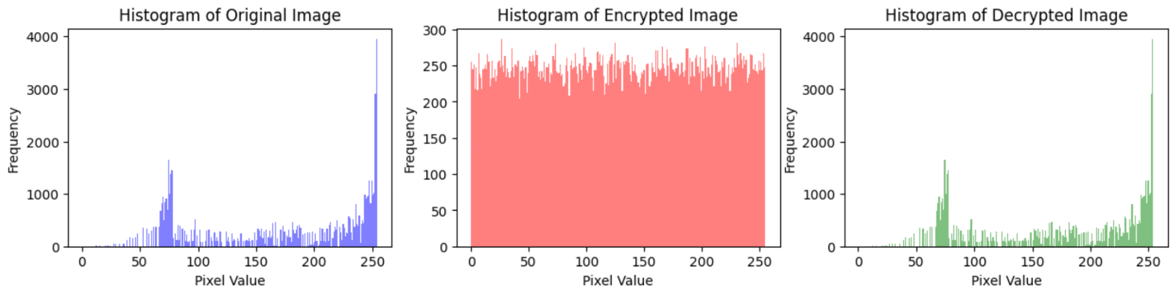
The distribution of an image's pixel values is visualised using a histogram plot
The blue histogram of the original image in Fig 1.9 reveals that the bulk of pixel values are in the range of 50 to 250, with a sharp drop in values at around 200, indicating that the general tone of the image is darker.
The histogram of the encrypted image needs to be consistent enough to withstand statistical attacks. In Fig 1.10 the histogram of the encrypted image is a fairly uniform distribution.
The green histogram of the decrypted image as shown in Fig 1.11 has a comparable distribution of pixel values to the original image histogram i.e. Fig 1.9, proving that the encryption and decryption processes did not materially change the distribution of pixel values in the image. This implies that the encrypted image keeps the original image's general visual qualities.

Slide 36
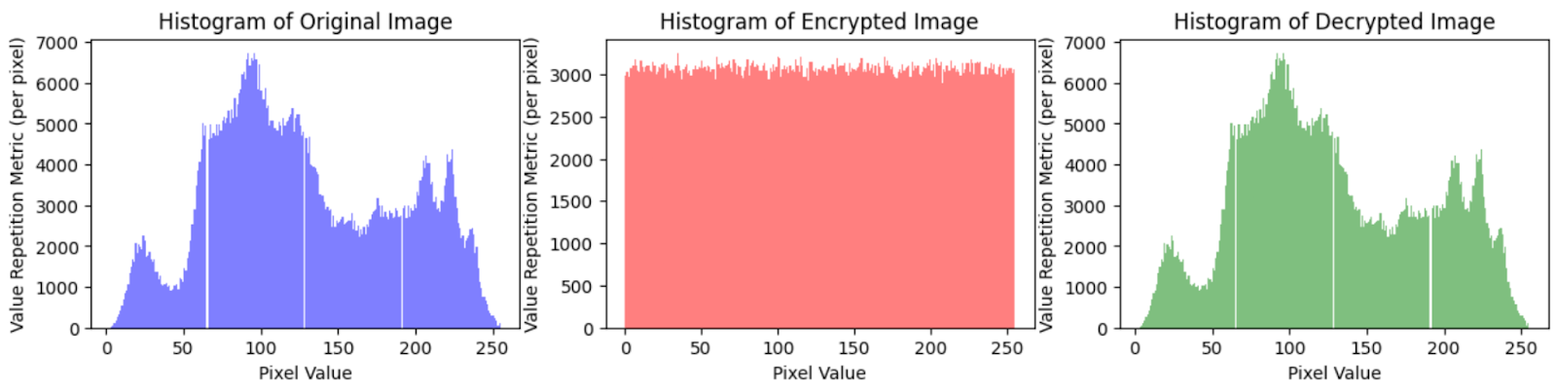
The pixel intensities of Lena image, as shown in Figure 5.8, show a distribution dispersed across a wide range of values, with a peak seen around the mid-range values.
This distribution shows that there is a variety of visual information in the Lena image, including both darker and brighter parts.The distributions of the decrypted image and the original Lena image are similar, as seen by a comparison of their histograms.
This suggests that the decryption procedure was successful in preserving the primary visual aspects of the original image without introducing appreciable modifications or adjustments.
Histogram Comparison for various bands

Slide 37
Conclusion
This study proposes an enhanced encryption algorithm for hyperspectral images that have been preprocessed and transformed to LAB color space. The suggested technique addresses the issues raised in the available research and seeks to minimize the trade-off between security and information loss. A novel encryption algorithm that overcomes the flaws of existing strategies by reviewing several encryption methods and evaluating their performance in terms of computational complexity, image quality and overall performance, is offered. Our findings show that the suggested approach is a reliable and efficient way for encrypting hyperspectral images, particularly in LAB color space. In terms of security, complexity and image quality, the approach surpasses current encryption techniques, demonstrating its potential for practical implementation in the safe storage of hyperspectral images. This effort significantly benefits the field of image encryption by introducing a novel encryption technique that can improve security while minimizing data loss. It also discusses the limitations and opportunities of future encryption, as well as the necessity for additional study into the creation of more robust encryption systems.

Slide 38
Future Work
In conclusion, this study shows the potential of utilizing encryption techniques to secure hyperspectral photos and contributes the groundwork for future research in this field. Considering the results, it is expected that this research will drive more research in this field in order to improve the security and accessibility of the systems, increasing the scope for research and industry.

Slide 39
References
[1] T. Adão, J. Hruška, L. Pádua, J. Bessa, E. Peres, R. Morais, and J. J. Sousa (2019) "Hyperspectral Imaging: A Review on UAV-Based Sensors, Data Processing and Applications for Agriculture and Forestry," Journal of Remote Sensing, Vol. 9, No. 11, pp. 1110 - 1140. doi: 10.3390/rs9111110.
[2] R. Bello-Cerezo, F. Bianconi, A. Fernández, E. González, and F. Di Maria (2018) "Experimental comparison of color spaces for material classification," Journal of Imaging, Vol. 4, No. 9, pp. 111-121. doi: 10.3390/jimaging4090111.
[3] B. Yang, H. Deng and L. Huang (2012) "A nonlinear image encryption method based on multivariate polynomials," Optik - International Journal for Light and Electron Optics, Vol. 123, No. 16, pp. 1401-1410, doi: 10.1016/j.ijleo.2011.09.011.
[4] M. F. Hassan (2022) "A uniform illumination image enhancement via linear transformation in CIELAB color space," Multimedia Tools and Applications, Vol. 81, pp. 26331-26343. doi: 10.1007/s11042-022-12429-7.
[5] H. Li, X. Bai, M. Shan, Z. Zhong, L. Liu, and B. Liu (2020) "Optical encryption of hyperspectral images using improved binary tree structure and phase-truncated discrete multiple-parameter fractional Fourier transform," J. Opt., Vol. 22, No. 5, pp. 55403-55412. doi: 10.1088/2040-8986/ab7ae8.
[6] J. Wang, L. Liu, M. Xu, and X. Li (2022) "A novel content-selected image encryption algorithm based on the LS chaotic model," J. King Saud Univ. - Comput. Inf. Sci., Vol. 34, No. 10, pt. A, pp. 8245-8259. doi: 10.1016/j.jksuci.2022.08.007.

Slide 40
[7] Y. Li, H. Jiang, and Y. Zhou (2021)"A Novel Image Encryption Algorithm Based on Multistage Chaos System and DNA Encoding," J. Comput. Theor. Nanosci., Vol. 18, No. 12, pp. 7655-7663. doi: 10.1166/jctn.2021.10913.
[8] J. M. M. Linhares, J. A. R. Monteiro, A. Bailão, L. Cardeira, T. Kondo, S. Nakauchi, M. Picollo, and J. C. Neves (2019) "How good are RGB cameras retrieving colors of natural scenes and paintings?—A study based on hyperspectral imaging," Color Res. Appl., Vol. 44, No. 4, pp. 598-610. doi: 10.1002/col.22398.
[9] J. Liu and Y. Liu (2016) "An image encryption scheme based on hyper-chaotic system and dynamic state variables," Multimed. Tools Appl., Vol. 75, No. 16, pp. 9915-9928. doi: 10.1007/s11042-016-3688-2.
[10] M. J. Khan, H. S. Khan, A. Yousaf, K. Khurshid and A. Abbas (2018) "Modern Trends in Hyperspectral Image Analysis: A Review," in IEEE Access, Vol. 6, pp. 14118-14129, doi: 10.1109/ACCESS.2018.2812999.
[11] T. A. Setyawan, S. A. Riwinanto, Helmy, A. Nursyahid, and A. S. Nugroho (2018), "Comparison of HSV and LAB Color Spaces for Hydroponic Monitoring System," in 2018 5th International Conference on Information Technology, Computer, and Electrical Engineering (ICITACEE), pp. 1-6. doi: 10.1109/icitacee.2018.8576991.
[12] C. Song and Y. Qiao (2015) "A novel image encryption algorithm based on DNA encoding and spatiotemporal chaos," Math. Probl. Eng., Vol. 2015, pp. 1-11. doi: 0.1155/2015/251723.

Slide 41
[13] X. Wang, X. Li, and Y. Li (2013) "A novel image encryption algorithm based on hyper-chaotic system," Opt. Commun., Vol. 291, pp. 242-247. doi: 10.1016/j.optcom.2012.09.041.
[14] L. Yang, Y. Wang, Y. Wei, J. Zhou, X. Wang, and W. Lu (2021) "A secure and high-efficiency image encryption scheme based on 3D Henon map and discrete wavelet transform," Signal Process. Image Commun., Vol. 97, pp. 116225-1162237. doi: 10.1016/j.image.2021.116225.
[15] Z. Yang, Y. Cao, S. Liu, C. Tanougast, W. Blondel, Z. Liu, and H. Chen (2022) "A Novel Signature and Authentication Cryptosystem for Hyperspectral Image by Using Triangular Association Encryption Algorithm in Gyrator Domains," Appl. Sci., Vol. 12, No. 15, pp. 7649-7660. doi: 10.3390/app12157649.
[16] E. Yavuz (2019), "A novel chaotic image encryption algorithm based on content-sensitive dynamic function switching scheme," Opt. Laser Technol., Vol. 114, pp. 224-239, 2019. doi: 10.1016/j.optlastec.2019.01.001.
[17] Y. Xian, X. Wang, X. Wang, Q. Li, and X. Yan (2022), "Spiral-Transform-Based Fractal Sorting Matrix for Chaotic Image Encryption," IEEE Transactions on Circuits and Systems I: Regular Papers, Vol. 69, No. 8, pp. 3320-3327, doi: 10.1109/TCSI.2022.3172116.
[18] X. Wang and P. Liu (2022) "A New Full Chaos Coupled Mapping Lattice and Its Application in Privacy Image Encryption," in IEEE Transactions on Circuits and Systems I: Regular Papers, Vol. 69, No. 3, pp. 1291-1301, doi: 10.1109/TCSI.2021.3133318.

Slide 42
[19] X. Yang, Y. Ye, X. Li, R. Y. K. Lau, X. Zhang and X. Huang (2018), "Hyperspectral Image Classification With Deep Learning Models," in IEEE Transactions on Geoscience and Remote Sensing, Vol. 56, No. 9, pp. 5408-5423, doi: 10.1109/TGRS.2018.2815613.
[20] H. Zhang, H. Chen, H. Zhang, H. Xie, and Y. Li (2021), “A Novel Image Encryption Algorithm Based on Multiple Chaotic Maps and DNA Encoding," IEEE Access, Vol. 9, pp. 90363-90375. doi: 10.1109/ACCESS.2021.3098795.

Slide 43
Thank You

